Slide 1

Adventure Time
Angela Raymond & Darla Hongmanivanh

Slide 2

Our databases keeps track of the thrill seeking adventures for all the outdoorsy customers who are one with nature.

Slide 3
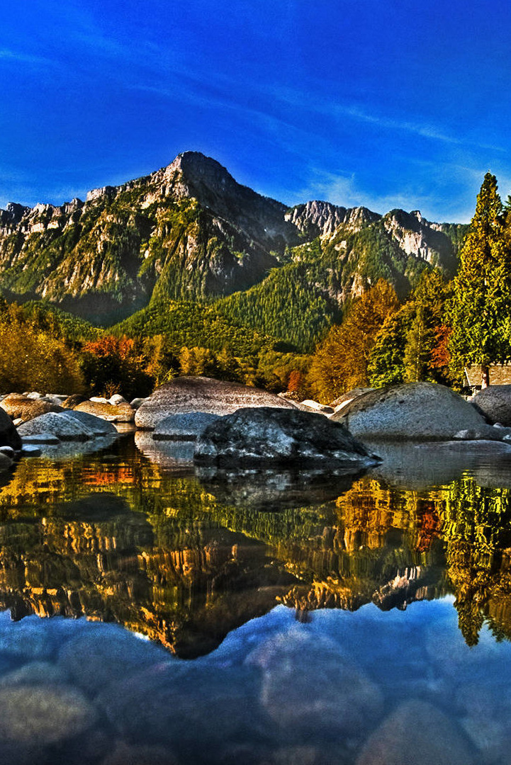
Our application
Goals:
Inserting new and exciting tours
Deleting any cancelled reservations
Reporting our customer’s reservations
Modifying any of our customer’s adventure date due to inclement weather or unexpected events

Slide 4
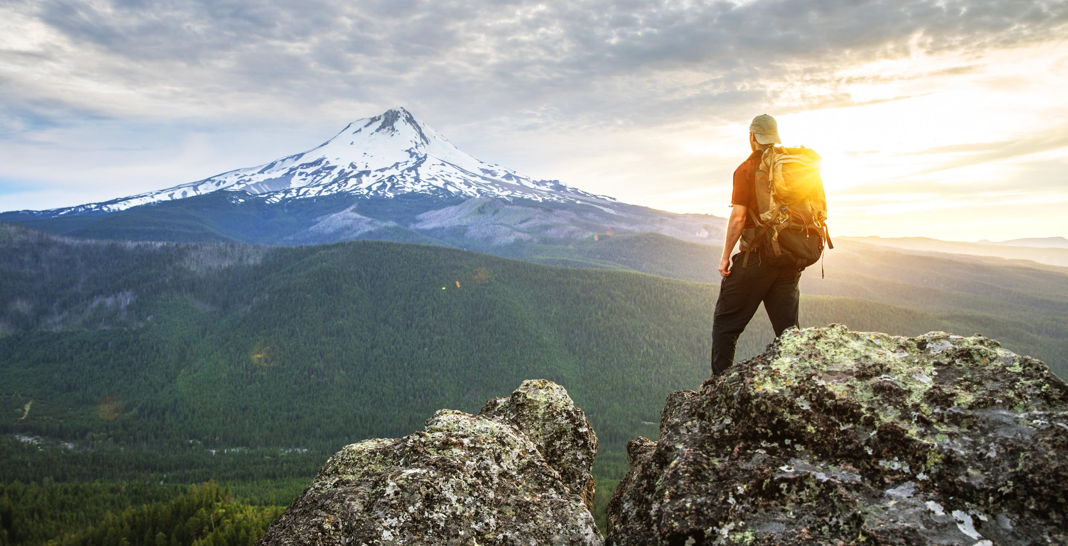
Our Database

Slide 5
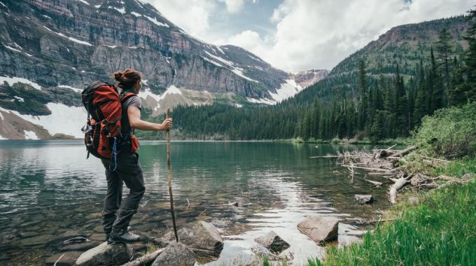
Customer
This holds all the important Customer contact information

Slide 6
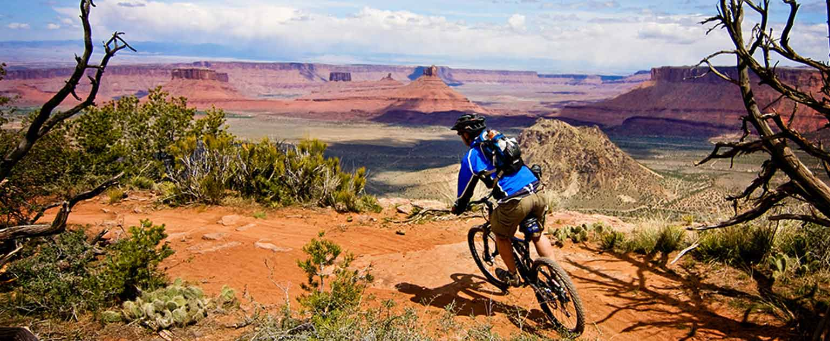
Reservation
This table indicates
The date of the adventure
The number of people reserved for the adventure
The price of the adventure per person

Slide 7
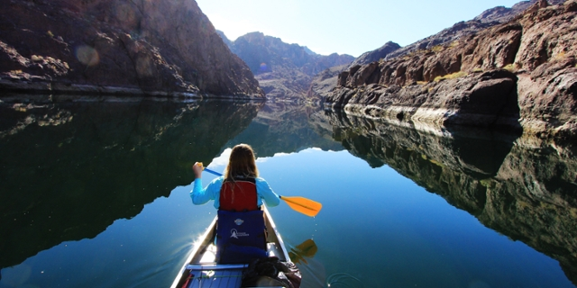
Tour
A basic term for our fun adventures where
The cool name of each adventure is stored
The location of each adventure
The state in which each adventure takes place
The distance (in miles) each adventure is
The maximum group size each adventure can handle
The type of adventure takes place (Hiking, Biking, or Paddling)
The season each adventure is offered in

Slide 8
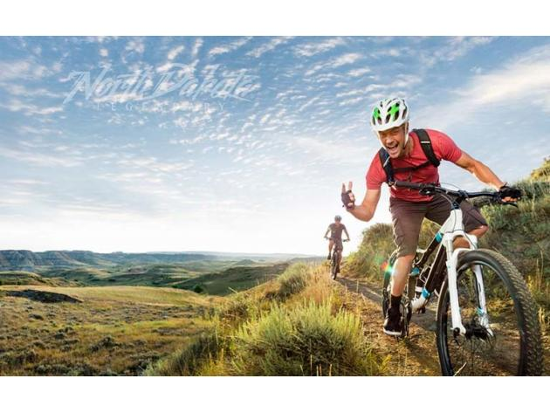
Guide
This table holds all the necessary contact information for each adventurous guide member we have

Slide 9
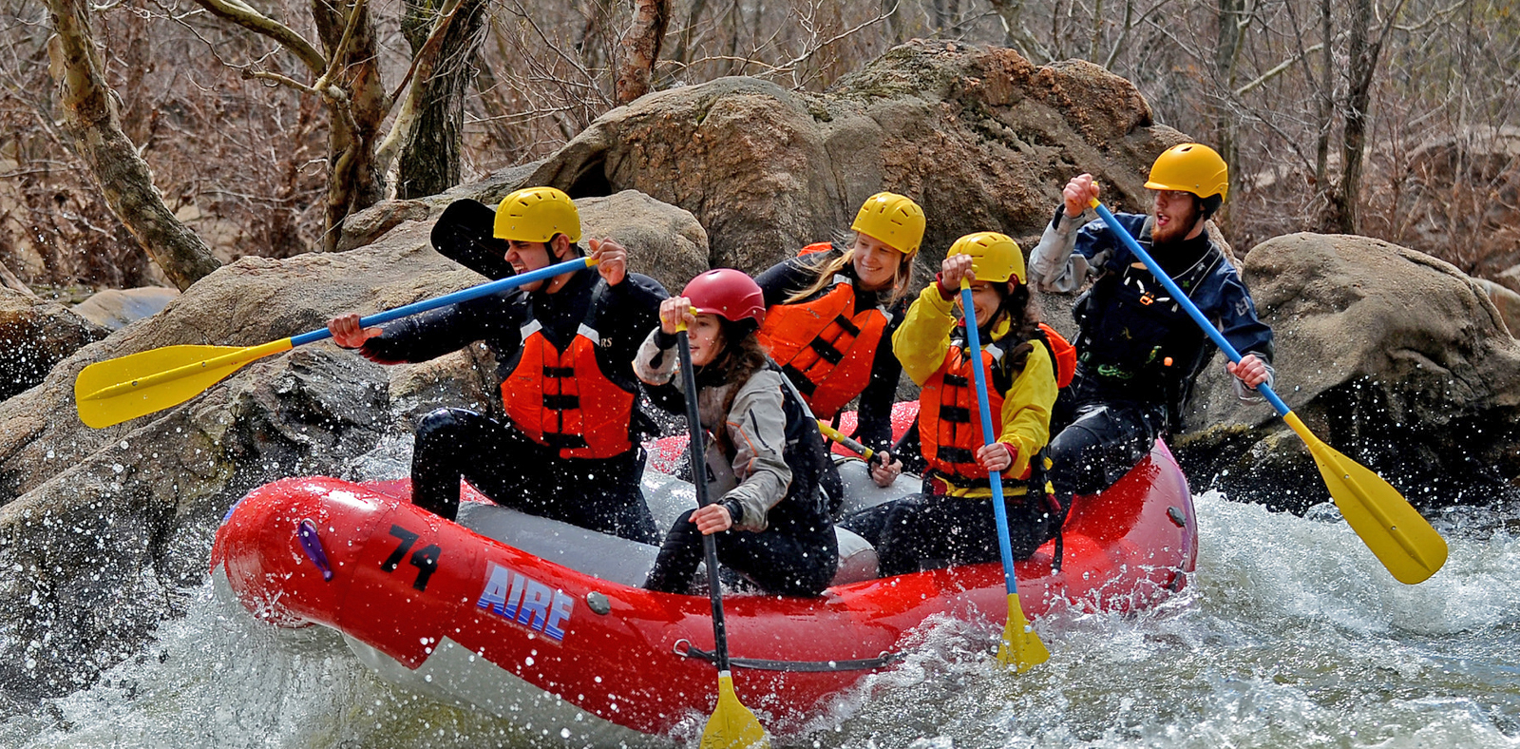
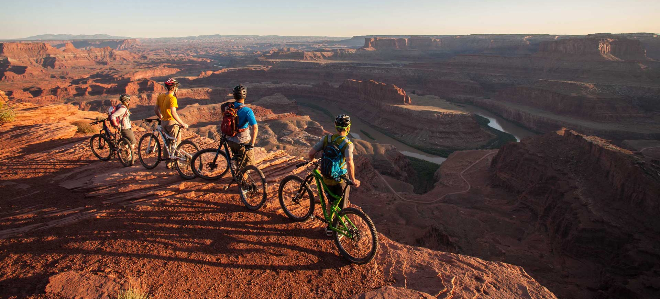
TourGuide
Indicates the Guide(s) for each fun adventure

Slide 10
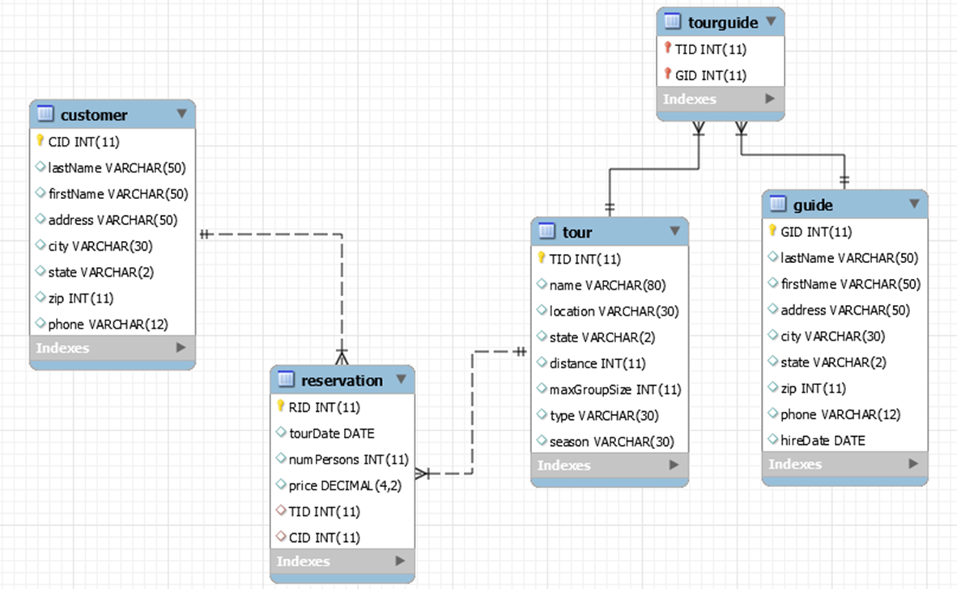
ERD
Our wonderful ERD that shows all the relationships among our database.

